Slide 1

Capstone Project Supervised ML - Regression NYC Taxi Trip Time Prediction Completed By : Ankush Kumar | Nayan Kumar Jha | Pinky Thakur

Slide 2
Points to Discuss:
Introduction and Problem Statement
Data Exploration
Analysis Methodology
Data Processing and Exploratory Data Analysis(EDA
Modelling
Final Modelling and Results
Conclusions and Summary
Implementing PCA (Principle Component Analysis)

Slide 3

Introduction and Problem Statement
Introduction:
There are numerous ways to get from one place in a city to another, but the taxi trip has more uses than any other mode of transportation in urban areas. When given the necessary set of parameters that influence trip duration, it becomes extremely important to analyse and forecast trip duration between two points in the city. The project serves as an appropriate way to understand the traffic system in New York City in order to provide a good taxi service and integrate it with the current transportation system. Predictions are made taking into account variables like pick-up latitude, pick-up longitude, drop-off latitude, drop-off longitude, etc.
Problem Statement:
The task is to create a model that forecasts how long taxi rides will last overall in New York City. Your main dataset, which includes pickup time, geo-coordinates, the number of passengers, and several other variables, was made public by the NYC Taxi and Limousine Commission.

Slide 4
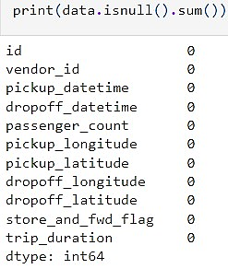
Data Exploration:
Dataset fil format: CSV(Comma Separated) file is used
Name of the data-source file : NYC Taxi Data.csv
Number of columns : 11
Number of rows : 1458644
Number of Numerical columns are: 7
Number of Categorical columns are: 2
Missing Values in the dataset
No missing value in any feature of our data.

Slide 5
Dataset Summary
Feature Columns / Variables:
id - a unique identifier for each trip
vendor_id - a code indicating the provider associated with the trip record
pickup_datetime - date and time when the meter was engaged
dropoff_datetime - date and time when the meter was disengaged
passenger_count - the number of passengers in the vehicle (driver entered value)
pickup_longitude - the longitude where the meter was engaged
pickup_latitude - the latitude where the meter was engaged
Feature Columns / Variables:
dropoff_longitude - the longitude where the meter was disengaged
dropoff_latitude - the latitude where the meter was disengaged
store_and_fwd_flag - This flag indicates whether the trip record was held in vehicle memory before sending to the vendor because the vehicle did not have a connection to the server - Y=store and forward; N=not a store and forward trip
Target Column/Variable:
trip_duration - duration of the trip in seconds.

Slide 6
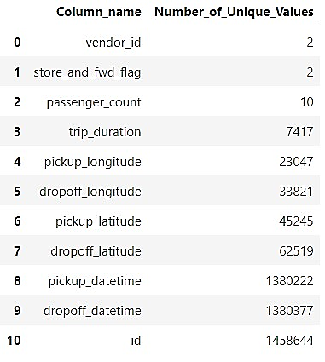
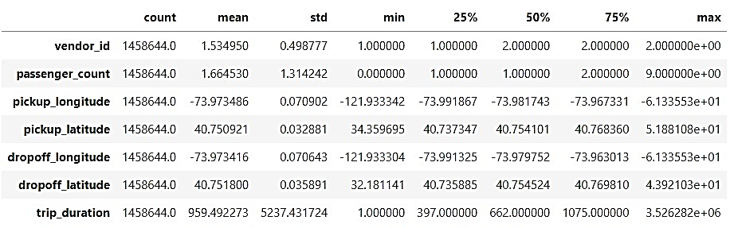
Unique Values and Five Point Statistical Summary

Slide 7
Analysis Methodology
Data Processing
Exploratory Data Analysis (EDA)
Correlation Analysis
Feature Transformation
Label Encoding
Standardizing Features
Modelling
Implementation of PCA
Final Modelling
Outlier Analysis

Slide 8
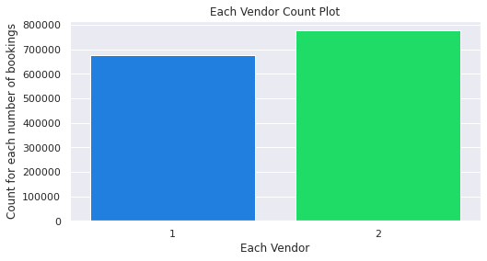
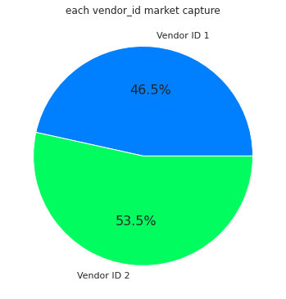
Exploratory Data Analysis (EDA)
Univariate Analysis
Checked how much bookings are done for each vendor type
We can see that for vendor 2 there are more number of bookings which is of 54 %

Slide 9
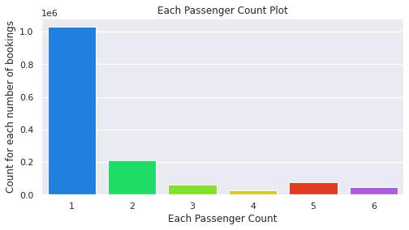
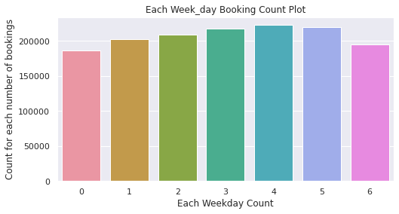
Checked how much bookings are done for each passenger_count
Checked the rate of bookings according to week days
Taxi ride is booked by only a single person there are more number of bookings is high as compare to multiple people booking the taxi ride.
Weekends 4 - Friday | 5 - Saturday there are high booking rate for taxi as compare to other days.

Slide 10
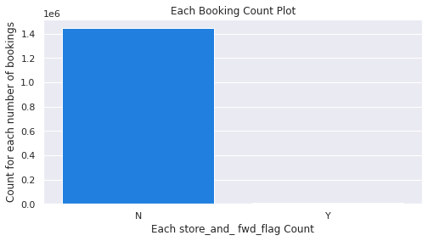
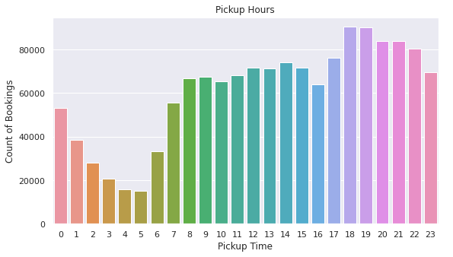
Checked how much bookings are done for each store_and_ fwd_flag Count
Checked number of booking hourly
Very less count when the store_and_ fwd_flag is Marked Yes and most of the time the taxi rider haven't connected to the servers of Vendor.
We can observe that morning after 10 O'clock people use to book taxi because they want to go out to their work places.
And at in the evening after 6 O'clock the taxi demand tends to in peak.

Slide 11
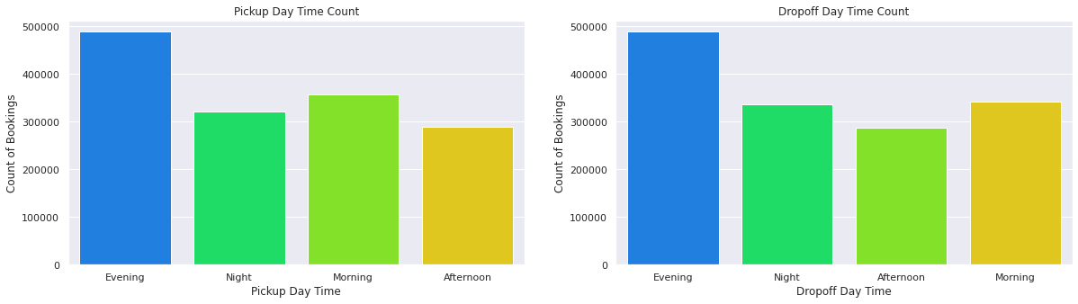
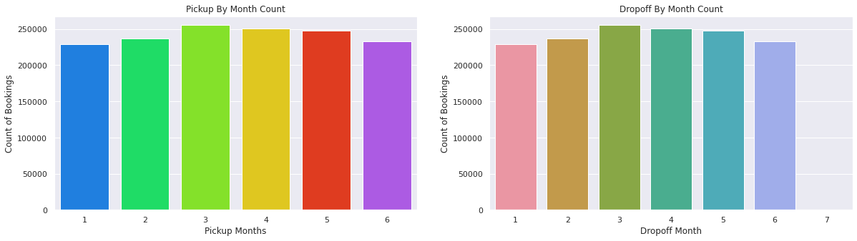
Checked the demand of taxi booking in each kind of day time
checked the bookings done per month
pickup and dropoff day time count plot booking count is maximum in the EVENING day time.
As we can see that in month of march and April there are more number of taxi booking occurred.

Slide 12
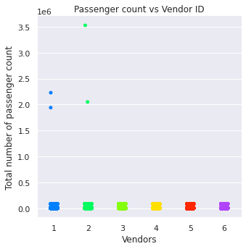
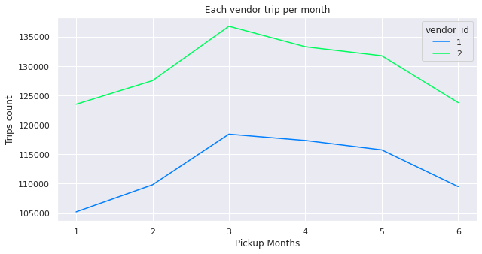
Bivariate and Multivariate Analysis
Checking monthly popularity of vendor
compared vnedor_id with monthly pickups
Both the vendors have the highest strips during the month of march and lowest at the Jan, Feb, and after June.
vendor 2 is more popular than vendor 1

Slide 13
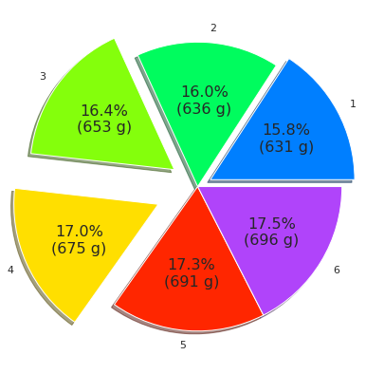
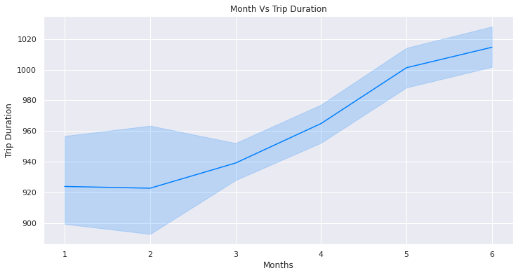
Each monthly average trip duration
Checked monthly trip duration
We can observe that least trip duration occured in january and highest started occuring after the month of march.
As we can see that trip duration start increases from 3rd month before that it is quite constant.

Slide 14
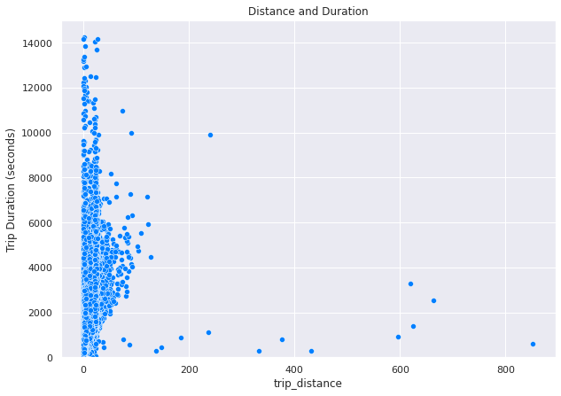
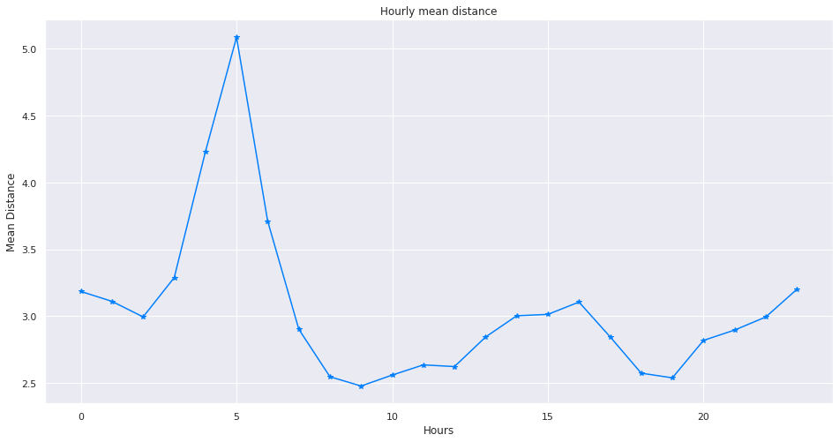
Compared trip_duration and distance.
Compared mean distance for each hour
We can see that 0-100 km distance have the dense trip durations.
The longest average distance is travelled from late at night until early in the morning.

Slide 15
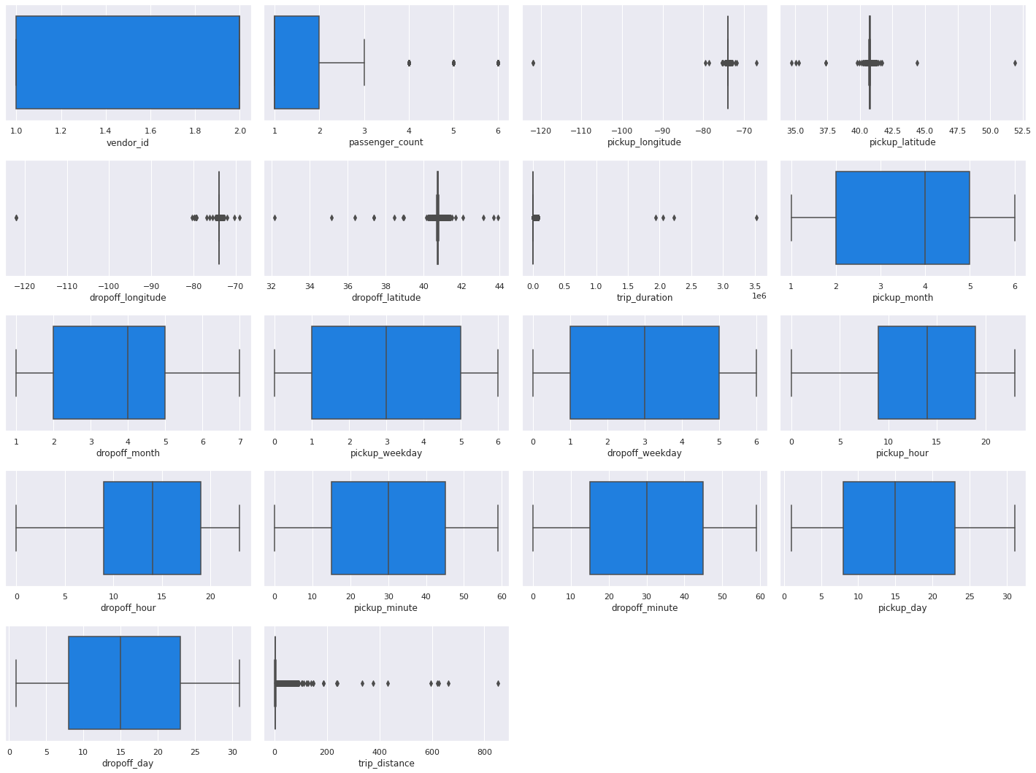
Outlier Analysis
As we already saw that trip duration has some trips that are not normal which are very higher like 900 + hrs in time duration but also we can see that there are some trip of no time.
If we try to remove that values till third standard deviation than also there will be outliers as trip duration contains duration of various and unique time let us try to transform our data so that we can get some improvement in our trip duration column.

Slide 16
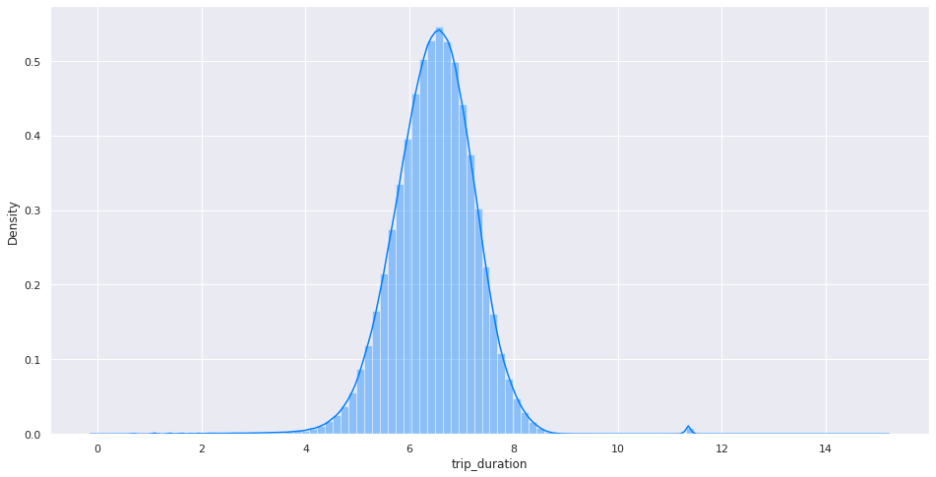
Outlier Analysis
OBSERVATION
Here we can observe that the distribution is now in normal distribution but also the is some small peak but we will use log transformed column for the training.

Slide 17
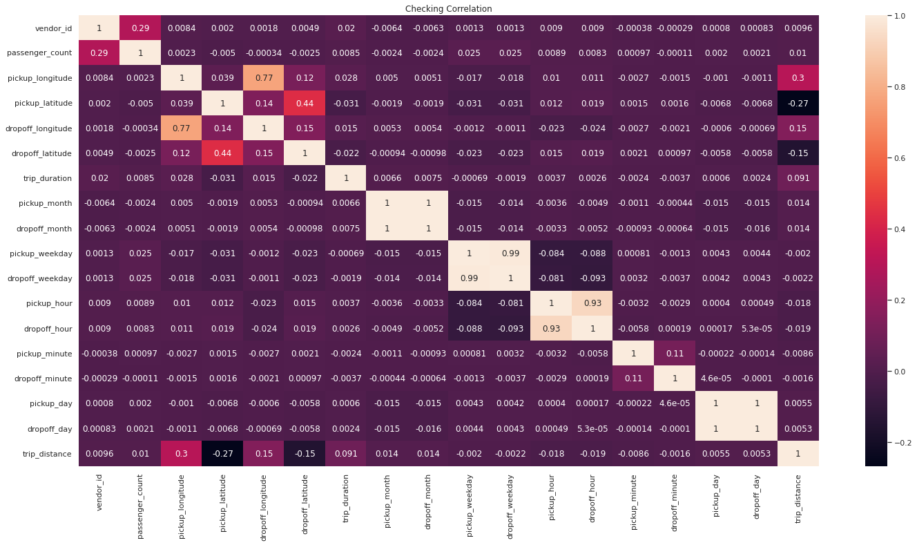
Correlation Analysis – Using Heatmap
As we can see that 'dropoff_day', 'dropoff_hour', 'dropoff_month', 'dropoff_weekday' are highly corelated we can drop these features

Slide 18
Feature Transformation
We have many features that have some categorical values in them like 'store_and_fwd_flag', 'pickup_day_time', 'dropoff_day_time’
We have applied LabelEncoder from Scikit Learn and transformed these features to numeric format.
LabelEncoder:
Sklearn is a very efficient tool for encoding categorical feature levels into numeric values. LabelEncoder encodes labels with values ranging from 0 to n classes-1, where n denotes the number of distinct labels.
We have used StandardScaler from Scikit Learn and transformed these features to standard normal form.
StandardScaler:
By deducting the mean from a feature and scaling it to unit variance, StandardScaler standardises it. Divide all the values by the standard deviation to get the unit variance. The strict definition of scale that I previously presented is not adhered to by StandardScaler.

Slide 19
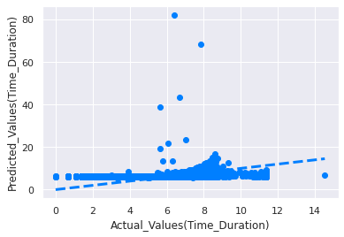
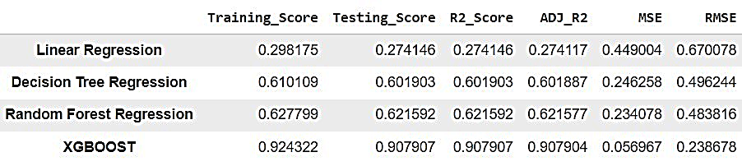
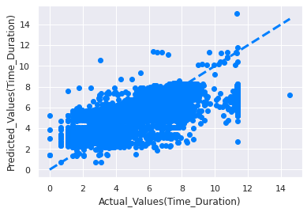
Modelling without implementing PCA
Linear Regression
Decision Tree
In terms of accuracy measure, which is not up to par, as well as in terms of R2, which is very low and RMSE, which is quite high, the linear regression model is not performing well at all. In terms of accuracy, R2, and RMSE evaluation for all matrices, Decision Tree Regressor and Random Forest Regressor perform marginally better than Linear Regression.

Slide 20
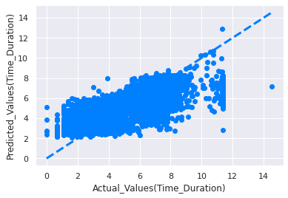
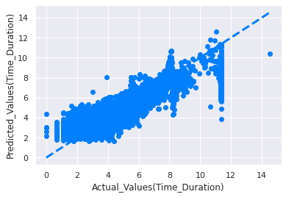
Modelling without implementing PCA
Random Forest
XGBOOST
But in terms of accuracy, R2 Score, and RMSE evaluation, Random Forest Regressor is marginally superior to Decision Tree Regressor. As we can see, XGBOOST is doing a fantastic job and offering us excellent training and testing accuracy. Additionally, the R2 score is much better than other models, and the RMSE value is also very low.

Slide 21
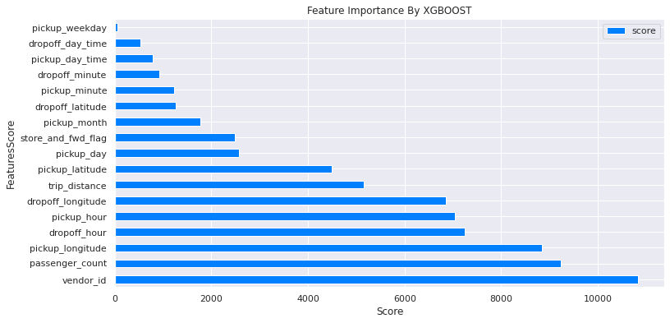
Feature Selection using Backward Elimination and XGBOOST Feature Importance:
Although Backward Feature Selection did not identify any features to remove, we can remove pickup_weakday from our data set so that our model can be trained.
After selecting the features using the backward elimination method and feature importance, the impact on the results is minimal.

Slide 22
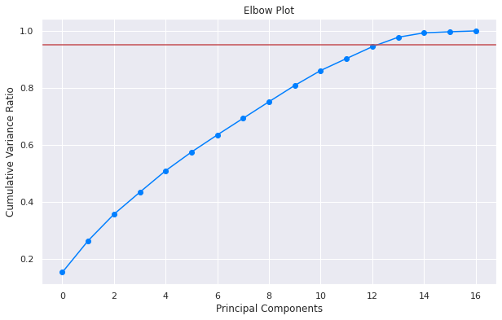
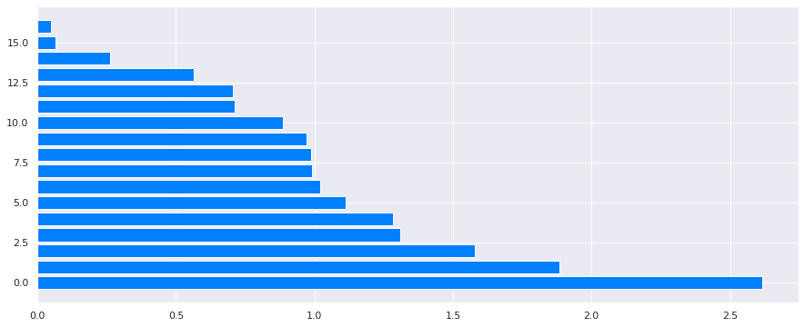
Implementation of PCA
Charts Showing the Important components after PCA transformation
12 PCA components were found to account for more than 90% of the variance.
So we have reduced the dimensionality of our feature data from 17 to 12

Slide 23
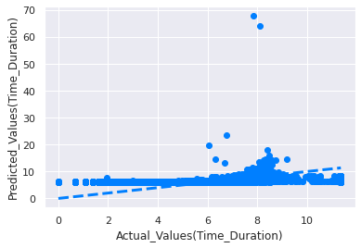
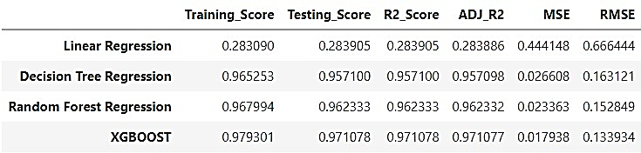
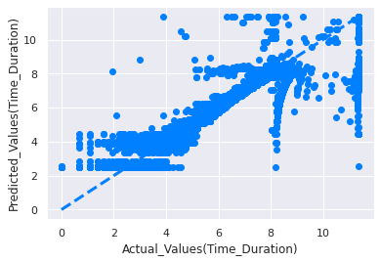
Modelling with implementing PCA
Linear Regression
Decision Tree
The linear regression model is completely underperforming.
After reducing the Dimension of our features, Decision Tree and Random Forest are now performing very well here, and other evaluation matrices are also producing respectable results.

Slide 24
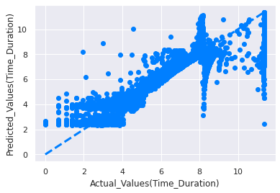
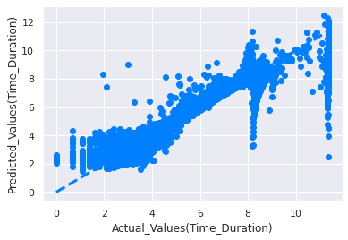
Modelling with implementing PCA
Random Forest
XGBOOST
But in terms of accuracy, R2 Score, and RMSE evaluation, Random Forest Regressor is marginally superior to Decision Tree Regressor.
As we can see, XGBOOST is doing a fantastic job and offering us excellent training and testing accuracy. Additionally, the R2 score is much better than other models, and the RMSE value is also very low.

Slide 25
Conclusions
We can see that we used a variety of models and methodologies, and that, with the exception of Decision Tree and Random Forest Regression, XGBOOST performed flawlessly in every case.
However, after applying PCA to our features and successfully reducing the feature dimension, we discovered that Decision Tree and Random Forest were performing just as well, if not better, than before transformation.
Furthermore, XGBOOST performs better after PCA transformation, and it shows marginally better results in terms of RMSE | MSE, which are lower than those of other models, as well as R2 | Adj R2 scores, which are higher than those of other models.
As a result, we can use the XGBOOST Regressor to achieve high prediction rates and lower error rates. It can also be improved by using finer-tuned hyperparameters.

Slide 26
THANK YOU

